Slide 1
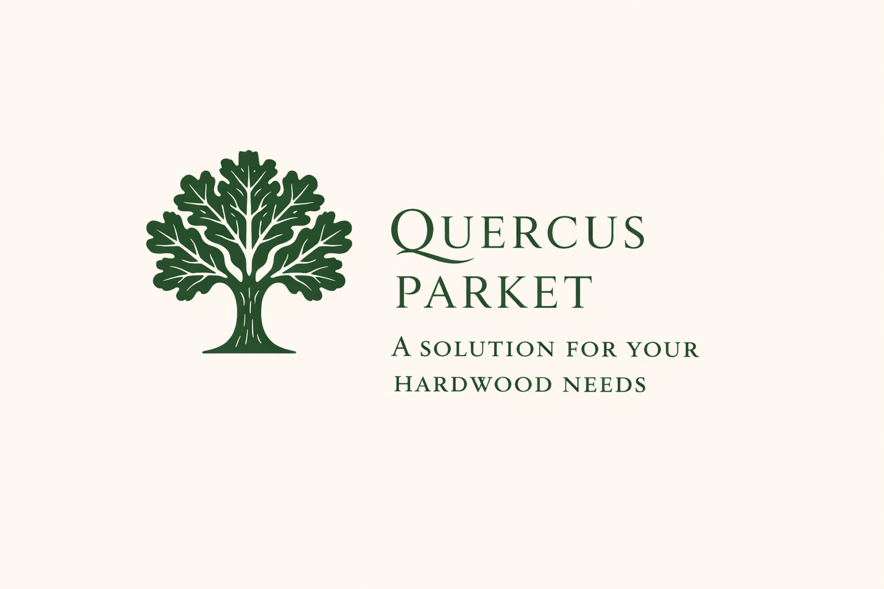

Slide 2
Introduction
Second-generation, family-owned sawmill (est. 1997) focused on precision, consistency, and quality
Production of high-grade ash and oak lumber, as well as classic solid and engineered parquet
Core specialization: Quercus robur (common oak) — widely known as Slavonian oak, valued for strength, structure, and timeless appearance
Fully traceable and compliant sourcing (EUDR, EUTR, UKTR, Lacey Act) across Southeast Europe
Primary origin: Morović forest (Serbia) — premium, sustainably managed oak with long-standing forestry tradition
Integration of traditional expertise with advanced production, supported by international manufacturing partnership (Cambodia)

Slide 3
History
1997–2009 | STRELA Era: Foundation phase – largest Serbian oak & ash sawmill, focused on precision and high-volume export
Long-term contract with Vojvodinašume ensured continuous supply of premium Slavonian oak (Quercus robur)
Strong international presence (EU, Middle East) + landmark projects (e.g. Azerbaijani Royal Palace)
2009–2020 | QUERCUS PARKET Era: Strategic shift from volume to specialization and partnerships
Established as trusted supplier of semi-finished oak components to leading flooring manufacturers (e.g. Tarkett, Bauwerk, Weitzer)
2020–Present | CAMPICO Era: Global expansion through JV in Cambodia – advanced 3-layer oak flooring production for US market
Integration of European raw material expertise with international manufacturing and distribution networks
Continuous development: from large-scale sawmill to specialized, globally connected oak producer — still family-owned, now led by second generation

Slide 4
Turnkey Hardwood Processing Facility
Turnkey Industrial Hardwood Platform (Serbia) – fully operational, established 1997, immediate revenue generation
Prime Location Advantage – direct access to Slavonian oak (Quercus robur) supply (Morović & Spačva Basin) + fast connectivity to EU & global markets
Proven Financial Performance – ~€16.5M revenue, ~€2M profit, ~100 employees, scalable industrial footprint
Fully Equipped & Operational – established production infrastructure (8,000 m² facilities + 36,000 m² site) with high-capacity European machinery
Secure & Compliant Raw Material Supply – long-term contract with Vojvodinašume + FSC-certified sourcing (EUDR, EUTR, Lacey Act compliant)
Scalable Upside Potential – ready for expansion into veneer, wear layers, and engineered wood (no greenfield investment required)
Strategic Investment Positioning – vertically integrated platform combining sourcing, processing, and export with nearly 30 years of operational track record

Slide 5
Sourcing, Compliance & Traceability
Fully Compliant Log Sourcing – oak (Quercus robur – Slavonian oak) and ash (Fraxinus excelsior) sourced exclusively from legally harvested forests
Controlled Regional Supply Base – Serbia, Croatia, Bosnia & Herzegovina, Romania; core sourcing from Morović forest (Serbia)
Long-Term Supply Security – established partnership with state forestry enterprise (Vojvodinašume) + verified regional supplier network
Strict Supplier Verification – legal documentation, harvesting rights, and continuous compliance monitoring; FSC and equivalent standards where applicable
End-to-End Traceability System – full tracking from forest origin to final product (documentation, transport records, internal controls)
Regulatory Compliance – aligned with EUTR, EUDR, UKTR, and US Lacey Act; low risk of non-compliant timber
Risk Mitigation Framework – multi-supplier strategy, preference for state forests, physical verification, and ongoing audits
Sustainability Commitment – responsible sourcing, forest regeneration support, and efficient material utilization

Slide 6
Market Opportunity – European Oak & Hardwood
Strong Global Demand – consistent demand for high-quality oak and ash in furniture, interiors, and industrial applications
Premium Resource Constraint – Slavonian oak (Quercus robur) is limited in supply and highly valued for strength, structure, and quality
Strategic Importance of Southeast Europe – core sourcing region for Europe’s highest-grade hardwood with established forestry systems
Shift Toward Certified Timber – increasing regulatory pressure (EUDR, ESG) favors fully compliant and traceable suppliers
Stable Industrial Demand Base – long-term consumption across multiple industries ensures resilient market fundamentals
Opportunity for Reliable Suppliers – fragmented supply side creates advantage for established, scalable, and compliant producers

Slide 7
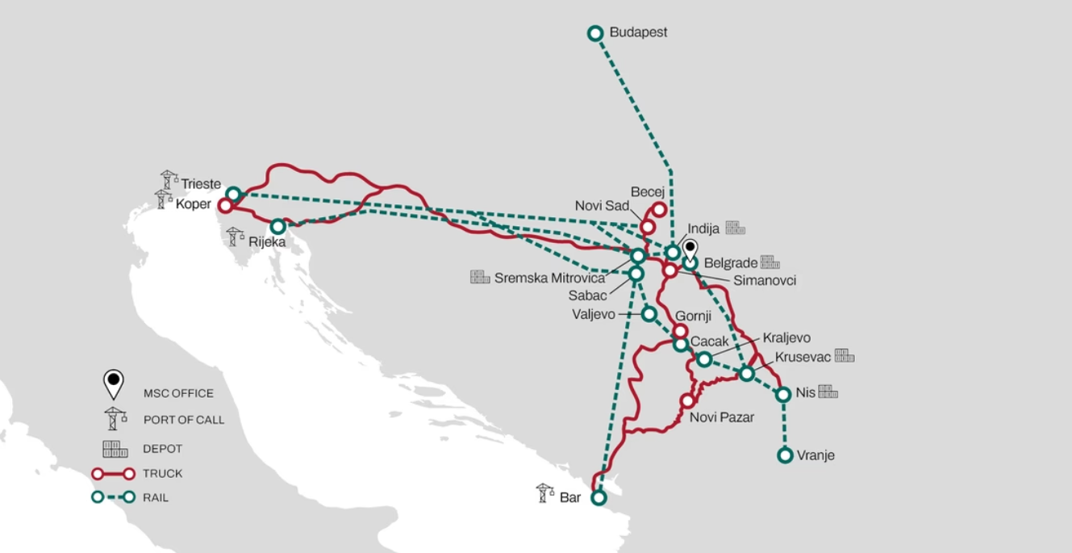
Strategic Hub – Raw Material & Export Access
Located in the Srem region (Serbia), near Belgrade – a key logistics and transport hub
35 minutes to Belgrade International Airport – fast access for international travel and business operations
10 minutes to major European highways (E-70, E-75) – direct road connectivity to EU markets
Close to rail and customs terminal (Inđija) – enabling efficient export and streamlined logistics
Immediate proximity to key sourcing areas – Morović forest (Serbia) and Spačva Basin (Croatia) for premium Slavonian oak

Slide 8


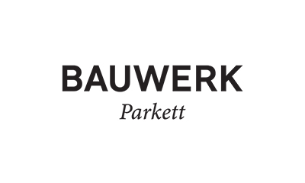
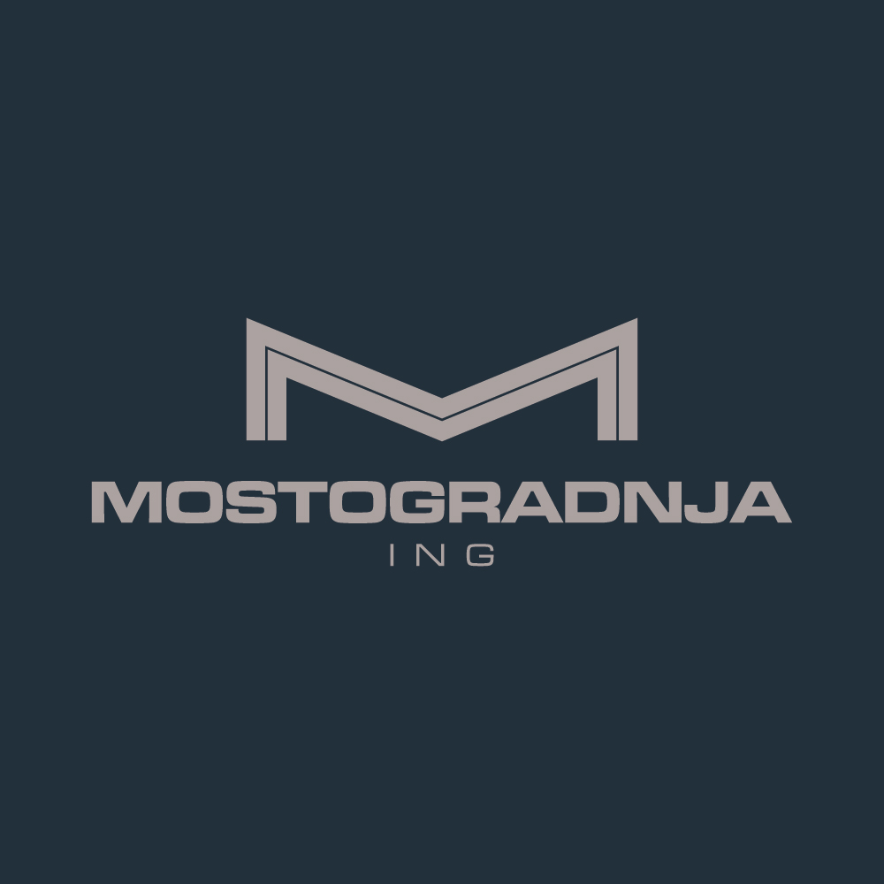


Client Portfolio & References
Member of FORDAQ (Bronze Level)

Slide 9
Contact & Company Details
QUERCUS PARKET – Sole Proprietorship
Address:
Nikole Tesle 137, 22321 Ljukovo, Serbia
Contact:
Email: quercus.parket@gmail.com
Phone: +381 22 58 77 50
Working Hours:
Monday – Friday | 07:00 – 15:00
Company Information:
TIN (PIB): 106197782
Registration No. (MB): 61620117
Banking Details:
OTP Bank Serbia (Novi Sad)
IBAN (EUR): RS35 3259 6015 0046 8686 36
SWIFT: OTPVRS22
Location Reference:
Pilana “Strela” – Quercus Parket (Google Maps)
FSC Holder Licence: C214521

Slide 10
THE END. THANK YOU!
Legal Notice:© QUERCUS PARKET. All rights reserved.All information contained in this presentation is confidential and intended solely for the recipient.No part of this presentation may be reproduced, distributed, or disclosed without prior written consent of QUERCUS PARKET.

Slide 11
